Slide 1


<Name>
<Date>

Slide 2

Outline
Executive Summary
Introduction
Methodology
Results
Conclusion
Appendix

Slide 3
Executive Summary
Summary of methodologies
Data Collection
Data Wrangling
EDA with data visualization
EDA with SQL
Building an interactive map with Folium
Building a Dashboard with Plotly Dash
Predictive analysis (Classification)
Summary of all results
EDA analysis
Interactive analysis
Predictive analysis

Slide 4
Introduction
Project background and context
SpaceX advertises Falcon 9 rocket launches on its website, with a cost of 62 million dollars; other providers cost upward of 165 million dollars each, much of the savings is because SpaceX can reuse the first stage
Problems you want to find answers
The project task is to predict if the first stage of the SpaceX Falcon 9 rocket will land successfully

Slide 5

Section 1

Slide 6
Methodology
Executive Summary
Data collection methodology:
SpaceX Rest API
Web Scrapping from Wikipedia
Perform data wrangling
One Hot Encoding data fields for Machine Learning and data cleaning of null values and irrelevant columns.
Perform exploratory data analysis (EDA) using visualization and SQL
Perform interactive visual analytics using Folium and Plotly Dash
Perform predictive analysis using classification models
Logistic regression, K-Nearest Neighbour, Decision Tree models have been build and evaluated for the best classifier.

Slide 7
Data Collection
The following datasets were collected:
SpaceX launch data that is gathered from the SpaceX REST API.
This API will give us data about launches, including information about the rocket used, payload delivered, launch specifications, landing specifications, and landing outcomes.
The SpaceX REST API endpoints, or URL, starts with api.spacexdata.com/v4/.
Another popular data source for obtaining Falcon 9 Launch data is web scraping Wikipedia using BeautifulSoup
SPACEX REST API
SPACEX to .JSON
Normalize data to CSV
Data consolidation and Wrangling
HTML Response from Wiki
Data Extraction using BeautifulSoup
Normalize data to CSV

Slide 8

Data Collection – SpaceX API
We used the get request to the SpaceX API to collect data, clean the requested data and did some basic data wrangling and formatting.
Github link: https://github.com/kiranistaken/testrepo/blob/main/API.ipynb

Slide 9
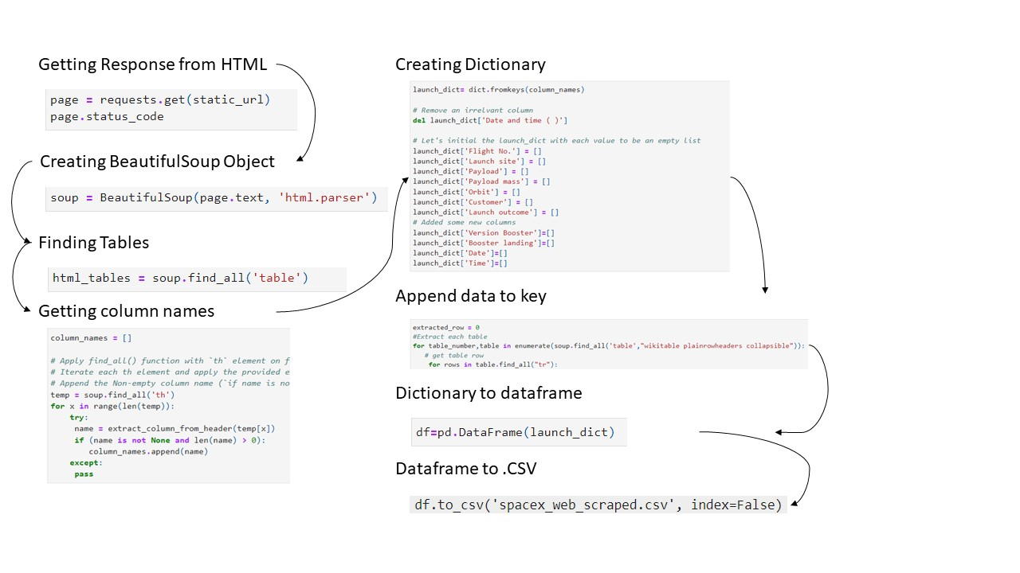
Data Collection - Scraping
Web Scrapping From Wikipedia
Github link:
https://github.com/kiranistaken/testrepo/blob/main/Final_Assignment.ipynb
Place your flowchart of web scraping here

Slide 10
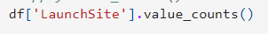
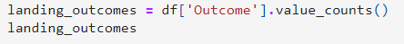
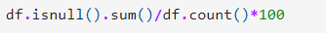
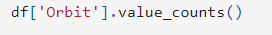
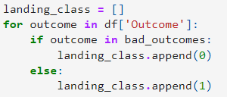
Check Null values
Calculate the number of launches on each site
Handel null values
Create a landing outcome label from outcome column
Calculate the number of occurrences of each orbit
Calculate the number of occurrences of mission outcome per orbit type
Data Wrangling
Github link:
https://github.com/kiranistaken/testrepo/blob/main/EDA%20lab.ipynb

Slide 11
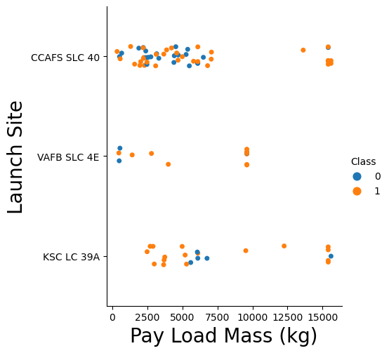
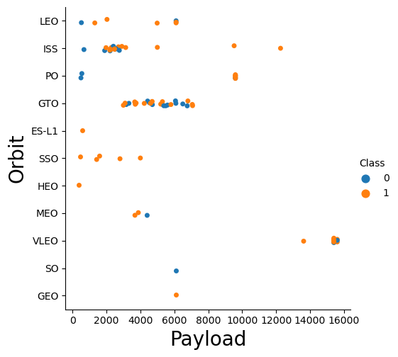
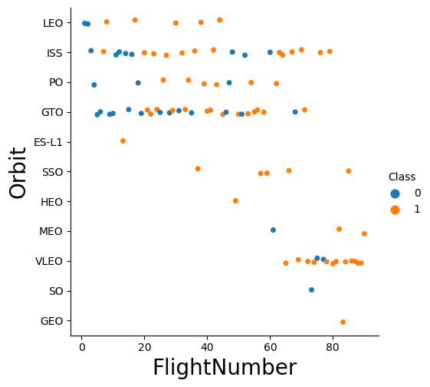
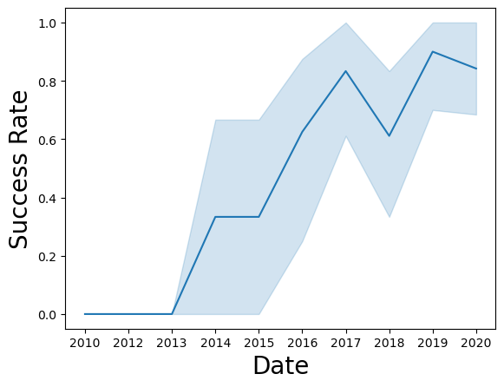
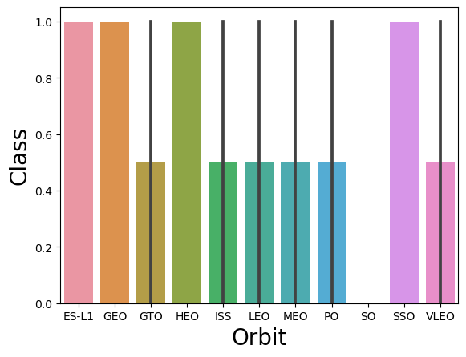
EDA with Data Visualization
Github Code: https://github.com/kiranistaken/testrepo/blob/main/EDA%20with%20visualisation.ipynb

Slide 12
EDA with SQL
SQL queries performed include:
Displaying the names of the unique launch sites in the space mission
Displaying 5 records where launch sites begin with the string 'KSC'
Displaying the total payload mass carried by boosters launched by NASA (CRS)
Displaying average payload mass carried by booster version F9 v1.1
Listing the date where the successful landing outcome in drone ship was achieved.
Listing the names of the boosters which have success in ground pad and have payload mass greater than 4000 but less than 6000
Listing the total number of successful and failure mission outcomes
Listing the names of the booster versions which have carried the maximum payload mass.
Listing the records which will display the month names, successful landing outcomes in ground pad, booster versions, launch site for the months in year 2017
Ranking the count of successful landing outcomes between the date 2010 06 04 and 2017 03 20 in descending order.
Github Code
https://github.com/kiranistaken/testrepo/blob/main/EDA%20SQL.ipynb

Slide 13
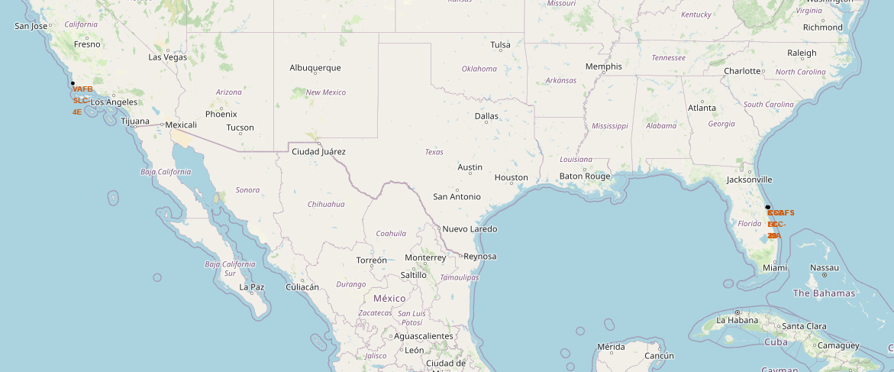
Build an Interactive Map with Folium
folium.Marker() was used to create marks on the maps.
folium.Circle() was used to create a circles above markers on the map.
folium.Icon() was used to create an icon on the map.
folium.PolyLine() was used to create polynomial line between the points.
folium.plugins.AntPath() was used to create animated line between the points.
markerCluster() was used to simplify the maps which contain several markers with identical coordination.
Github Code
https://github.com/kiranistaken/testrepo/blob/main/Visual%20analytics.ipynb

Slide 14
Build a Dashboard with Plotly Dash
Dash and html components were used as they are the most important thing and almost everything depends on them, such as graphs, tables, dropdowns, etc.
Pandas was used to simplifying the work by creating dataframe.
Plotly was used to plot the graphs.
Pie chart and scatter chart were used to for plotting purposes.
Range slider was used for payload mass range selection. Dropdown was used for launch sites.
Github Code
https://github.com/kiranistaken/testrepo/blob/main/Visual%20analytics.ipynb

Slide 15
Predictive Analysis (Classification)
Building Model
Create column for the class
Train test split
GridSearchCV model
Evaluation Model
Calculate accuracies
Confusion matrices
Result plots
Finding the optimal model
Standardize the data
Best hyperparameters
Best model with highest accuracy
Optimal model
Github Code
https://github.com/kiranistaken/testrepo/blob/main/Predictive%20Analysis.ipynb

Slide 16
Results
Exploratory data analysis results
The SVM, KNN, and Logistic Regression models are the best in terms of prediction accuracy for this dataset.
Low weighted payloads perform better than the heavier payloads.
The success rates for SpaceX launches is directly proportional time in years they will eventually perfect the launches.
KSC LC 39A had the most successful launches from all the sites.
Orbit GEO,HEO,SSO,ES L1 has the best Success Rate.

Slide 17

Section 2

Slide 18
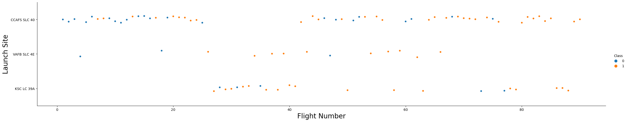
Flight Number vs. Launch Site
As number of flights increase There will be an increase in the success rate of launch sites

Slide 19
Payload vs. Launch Site
Increase in pay load mass lead to increase in launch site success

Slide 20
Success Rate vs. Orbit Type
ES-L1, GEO, HEO and SSO have a success rate of 100% and SO has a success rate of o%

Slide 21
Flight Number vs. Orbit Type
There is no relationship between GTO and Flight number

Slide 22
Payload vs. Orbit Type
First thing to see is how the pay load mass between 2000 and 3000 is affecting ISS.
Similarly How the pay load mass is affecting GTO between 3000 and 7000

Slide 23
Launch Success Yearly Trend
Since the year 2013, there was a exponential increase in the success rate with an except on a drop in 2018

Slide 24
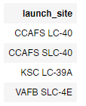
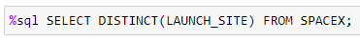
All Launch Site Names
We can get the unique values by using ‘DISTINCT’

Slide 25
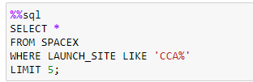
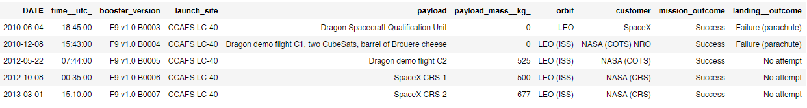
Launch Site Names Begin with 'CCA'
We can get only 5 row by using ‘LIMIT’

Slide 26
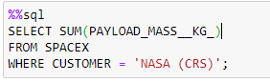
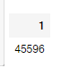
Total Payload Mass
We can get the sum of all values by using ‘SUM’

Slide 27
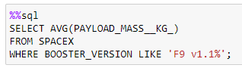
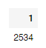
Average Payload Mass by F9 v1.1
We can get the average of all values by using ‘AVG’

Slide 28
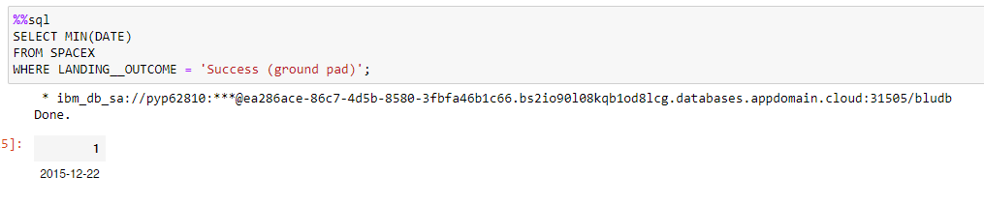
First Successful Ground Landing Date
We can get the first successful data by using ‘MIN’, because first date is same with the minimum date

Slide 29
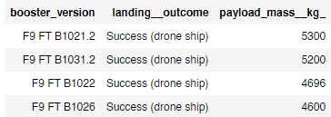
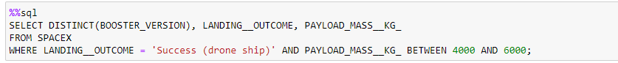
Successful Drone Ship Landing with Payload between 4000 and 6000
The payload mass data was taken between 4000 and 6000 and the landing outcome was determined to be ‘success drone ship’

Slide 30
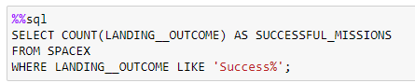
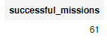
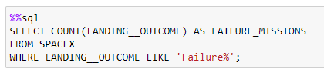
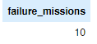
Total Number of Successful and Failure Mission Outcomes
We can get the number of successful mission by using ‘COUNT’ and LIKE ‘Success%’
We can get the number of Failed mission by using ‘COUNT’ and LIKE ‘Failure%’

Slide 31
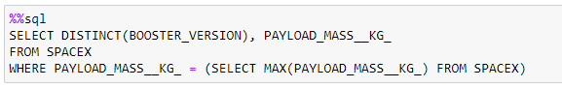
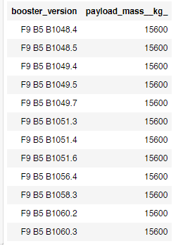
Boosters Carried Maximum Payload
We can get the maximum payload masses by using ‘MAX’

Slide 32
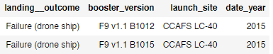
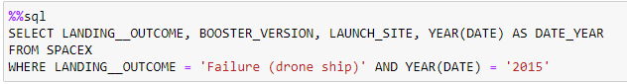
2015 Launch Records
We can get the months by using month(DATE) and in the WHERE function we assigned the year value to ‘2015’

Slide 33
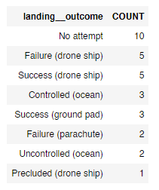
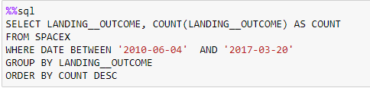
Rank Landing Outcomes Between 2010-06-04 and 2017-03-20
By using ‘ORDER’ we can sort the values in descending order and with ‘COUNT’ we can count all numbers as we did previously

Slide 34

Section 3

Slide 35

<Folium Map Screenshot 1>
All the launches are near USA, FLORIDA and CALIFORNIA

Slide 36

<Folium Map Screenshot 2>
Green = Success
Red = Failure

Slide 37

<Folium Map Screenshot 3>
All distances from launch sites to its proximities, they weren’t far from railway tracks

Slide 38

Section 4

Slide 39
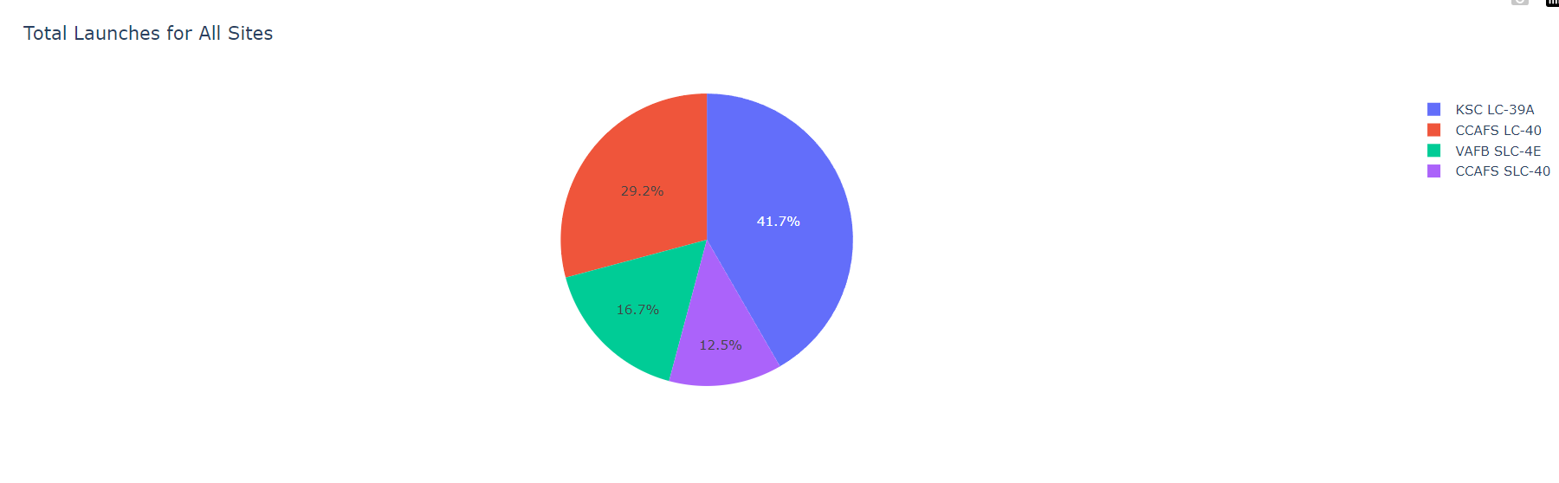
<Dashboard Screenshot 1>
KSC LC- 39A has the highest success score with 41.7%
CCAFS LC-40 has 29.2% success rate
VAFB SLC -4E – 16.7% success and
CCAFS SLC-40 – 12.5% success

Slide 40
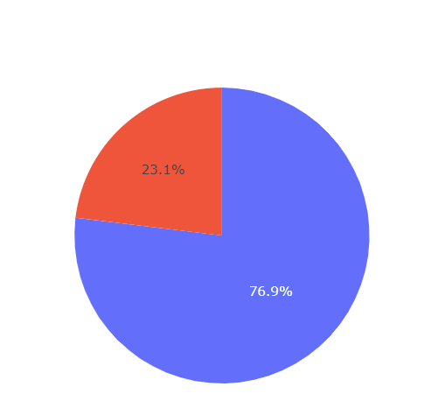
<Dashboard Screenshot 2>
KSC LC 39A has the highest success rate of 76.9% with payload range of 2000 kg – 10000 kg

Slide 41
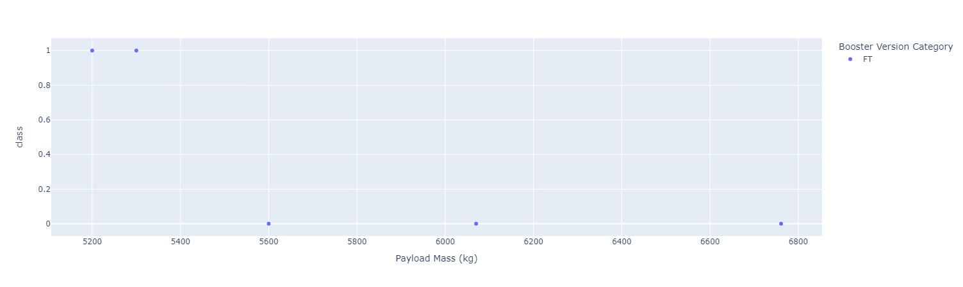
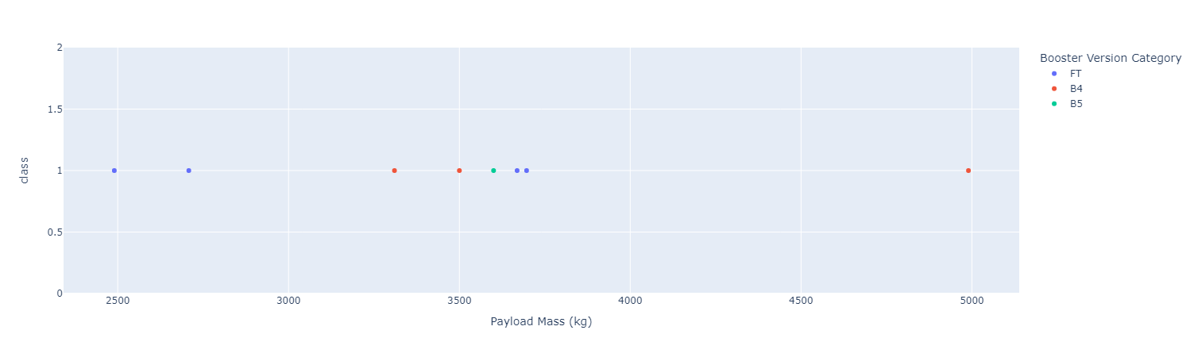
<Dashboard Screenshot 3>
Payload 0kg – 5000kg (first half)
Payload 6000kg – 10000kg (second half)

Slide 42

Section 5

Slide 43
Classification Accuracy
Decision tree has the highest accuracy of 0.89

Slide 44
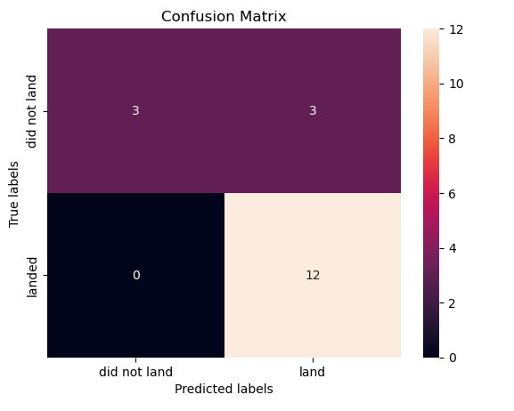
Confusion Matrix
Show the confusion matrix of the best performing model with an explanation

Slide 45
Conclusions
The SVM, KNN, and Logistic Regression models are the best in terms of prediction accuracy for this dataset.
Low weighted payloads perform better than the heavier payloads.
The success rates for SpaceX launches is directly proportional time in years they will eventually perfect the launches.
KSC LC 39A had the most successful launches from all the sites.* Orbit GEO,HEO,SSO,ES L1 has the best Success Rate.

Slide 46
Appendix
Github link: https://github.com/kiranistaken/testrepo

Slide 47


